Slide 1
Numerical calculus
S.J. Cheng
NCTU/EP

Slide 2
Numerical differentiation
Chapter 3, “An introduction to computational physics”,
Tao Pang, 2nd ed., Cambridge Univ. Press
C:\Users\sjche\Desktop\Work place\teaching\computational physics\numerical calculus\numerical differentials 2020.pptx

Slide 3
學習目標(03/23)
1/3:
Taylor expansion & discretization
First derivative: 2-, 3-, and 5-point formula & error assessment
Exercise 1 (y=sin(x))
Exercise 2(falling object)
2/3:
Second derivative
Exercise 3 (following ex.1)
Extrema of a function
3/3
HW review & Exercise

Slide 4
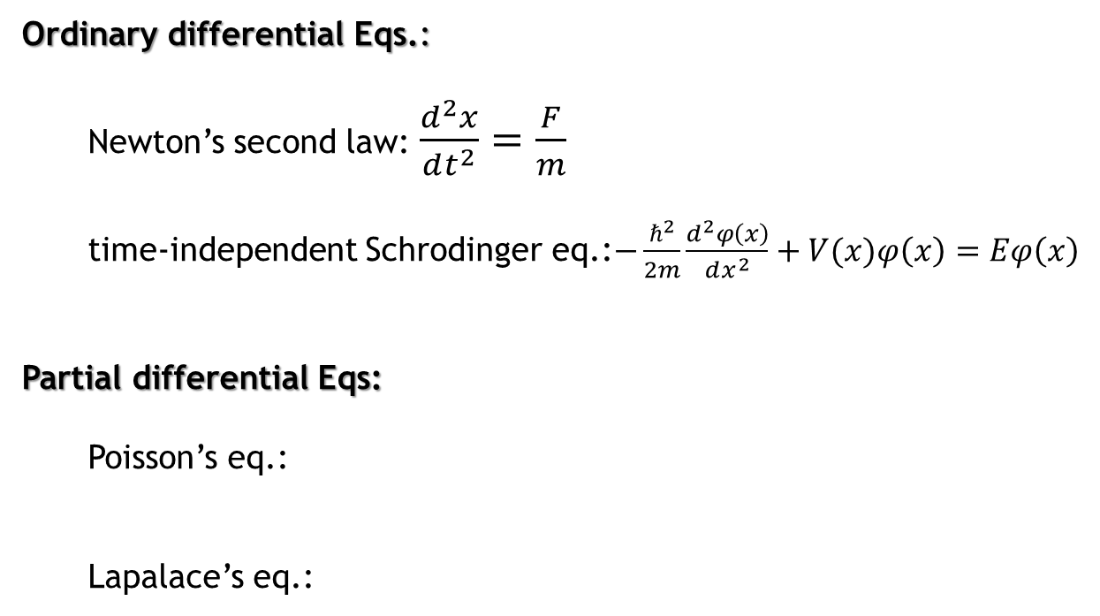
ODEs and PDEs
Ordinary differential Eqs.:
Newton’s second law: $\frac{d^{2}x}{dt^{2}}=\frac{F}{m}$
time-independent Schrodinger eq.:$−\frac{ℏ^{2}}{2m}\frac{d^{2}φ\left(x\right)}{dx^{2}}+V(x)φ\left(x\right)=Eφ\left(x\right)$
Partial differential Eqs:
Poisson’s eq.:
Lapalace’s eq.:

Slide 5




Taylor series
$$f(x)$$
$$f(x_{0})$$
$$x_{0}$$
$$x$$

Slide 6
Numerical differentiation: discretization method
x₀
x₁
Δx=h

Slide 7
The first-order derivative: two-point formula
(Forward difference)
x_{i}
x_{i+1}
h

Slide 8
The first-order derivative: three-point formula
x_{i-1}
x_{i}
x_{i+1}
h
h
(Central difference)
The accuracy of the expression increases to a higher order in h since more points are used.

Slide 9
The first-order derivative: five-point formula
HW: prove the five-point formula

Slide 10
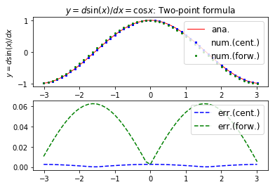
Numerical differentiation: 2 point formula
Example of the code using 2-point formula:
C:\Users\sjche\Desktop\Work place\teaching\computational physics\numerical calculus\numerical differential.py

Slide 11
Exercise: Numerical differentiation
exercise
C:\Users\sjche\Desktop\Work place\teaching\computational physics\numerical calculus\numerical differential.py

Slide 12
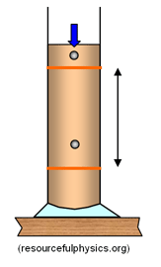
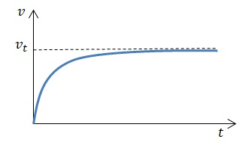
Fluid resistance and terminal speed
exercise
Ch.5, University Physics, Young & Freedman, Pearson

Slide 13
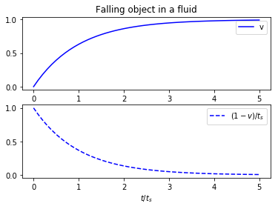
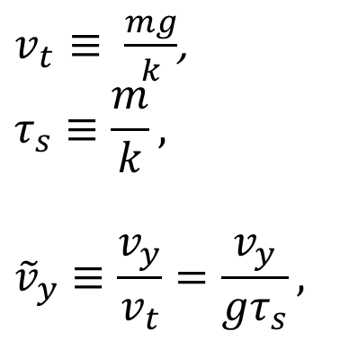
Tip: Simplifying eq. in terms of dimensionless variables
$v_{t}$ $≡ \frac{mg}{k}$,
$$τ_{s}≡\frac{m}{k},$$
$${\tilde{v}}_{y}≡\frac{v_{y}}{v_{t}}=\frac{v_{y}}{gτ_{s}},$$
dv/dt??
C:\Users\sjche\Desktop\Work place\teaching\computational physics\numerical calculus\velocity of falling obj.py

Slide 14
Numerical differentiation: second-order derivative
(Forward difference)
Proof:…

Slide 15
second-order derivative
Home work
HW: prove the following formula for second-order derivative

Slide 16
Exercise: 2nd order derivative
exercise

Slide 17
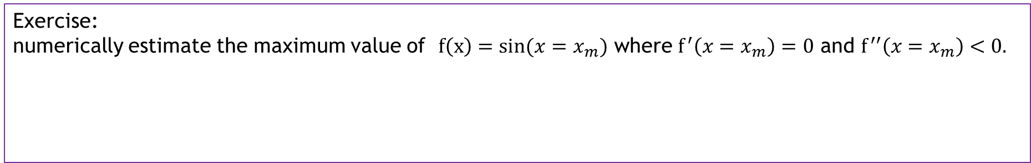
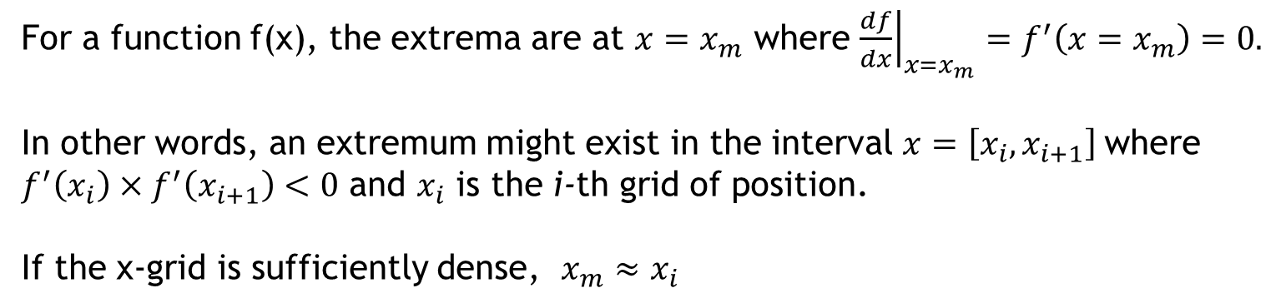
Extrema of a function
For a function f(x), the extrema are at $x=x_{m}$ where ${\left.\frac{df}{dx}\right|}_{x=x_{m}}=f^{′}\left(x=x_{m}\right)=0.$
In other words, an extremum might exist in the interval $x=\left[x_{i},x_{i+1}\right]$where $f^{′}\left(x_{i}\right)×f^{′}\left(x_{i+1}\right)<0$ and $x_{i}$ is the i-th grid of position.
If the x-grid is sufficiently dense, $x_{m}≈x_{i}$
exercise
Exercise:
numerically estimate the maximum value of $f\left(x\right)=sin(x=x_{m})$ where $f^{′}\left({x=x}_{m}\right)=0$ and $f^{′′}\left({x=x}_{m}\right)<0.$

Slide 18
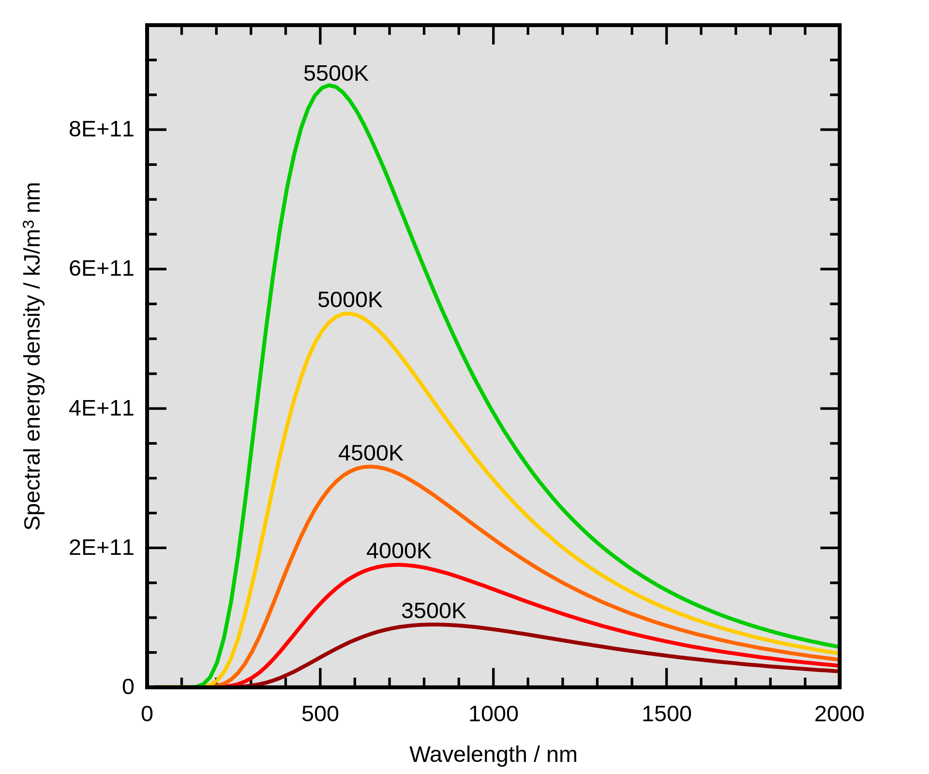
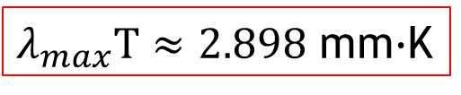
Blackbody radiation: Wien’s law
https://en.wikipedia.org/wiki/Wien%27s_displacement_law
Wien‘s displacement law states that the black-body radiation curve for different temperatures will peak at different wavelengths that are inversely proportional to the temperature.
The energy density of the blackbody radiation per unit wavelength is
Wien‘s displacement law:
$λ_{max}T≈2.898$ mm$∙$K

Slide 19
額溫槍

Slide 20

Homework: Wien’s law in Blackbody radiation
Home work
Plot out the energy density of blackbody radiation per unit wavelength versus wavelength
Find the wavelength where the energy density is maximum for the temperature T=3500K,4000K,..
Numerically confirm the Wien’s law.
$λ_{max}T≈2.898$ mm$∙$K
h=6.62607015×10⁻³⁴ Js
hc=1.98644586×10⁻²⁵ Jm
k=1.380649×10⁻²³JK ⁻¹

